Slide 1
DECENTRALIZED EXCHANGE WEB APP
BATCH – 4(4-CSE-D)

Slide 2

TEAM MEMBERS
S. SAI SRI VINAY REDDY - 19BQ1A05J7
T. CHANDRIKA - 19BQ1A05M9
S. KAARTHIKEYA - 19BQ1A05L5
Sk. SIDDIK - 19BQ1A05L0
T. SATYA AKHIL - 19BQ1A05P8
Under the supervision of
Dr. G. SANJAY GANDHI, Ph.D.

Slide 3

CONTENTS
Abstract
Introduction
Blockchain
Some technical terms
Problem Statement
Proposed Solution
Operating Environment
Future Enhancements
Results

Slide 4
ABSTRACT
A decentralized exchange (better known as a DEX) is a peer-to-peer marketplace where transactions occur directly between crypto traders. DEXs fulfill one of crypto’s core possibilities: performing financial transactions that can’t be done by banks, brokers, payment processors, or any other kind of intermediary. The most popular DEXs like Uniswap and Sushiswap utilize the Ethereum blockchain and are part of the growing suite of decentralized finance (DeFi) tools, which make a huge range of financial services available directly from a compatible crypto wallet. DEXs are booming. in the first quarter of 2021, $217 billion in transactions flowed through decentralized exchanges.

Slide 5


INTRODUCTION
Transition of web:
Web 1.0 : static websites, users can not add data
Web 2.0 : dynamic websites, users can add data, any third party can control that data, sometimes security is compromised.

Slide 6

Why web3.0 ?
Web3 has become a catch-all term for the vision of a new, better internet. At its core, Web3 uses blockchains, cryptocurrencies, and NFTs to give power back to the users in the form of ownership.

Slide 7
Blockchain
A blockchain is a type of distributed ledger technology (DLT) that consists of growing list of records, called blocks, that are securely linked together using cryptography.
Some of the popular applications of Blockchain are Decentralized Exchanges (DEX) and Decentralized Finance (DeFi)

Slide 8
Crypto Exchanges
In order to start buying and selling crypto currencies and other digital assets, the most common way is to transact with Crypto Exchanges. Cryptocurrency exchanges are privately-owned platforms that facilitate the trading of crypto currencies for other crypto assets, including digital and fiat currencies and NFTs.

Slide 9
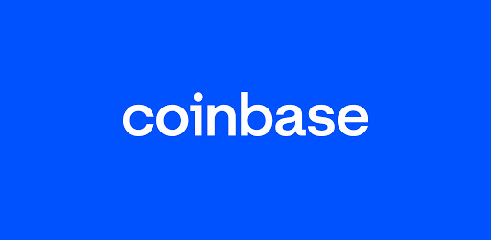
Centralized Cryptocurrency Exchanges (“CEX”)
Centralized cryptocurrency exchanges act as an intermediary between a buyer and a seller and make money through commissions and transaction fees. You can imagine a CEX to be similar to a stock exchange but for digital assets.
Popular Crypto Exchanges are Coinbase, Binance
Disadvantages
Hacking risk
Transaction fees

Slide 10
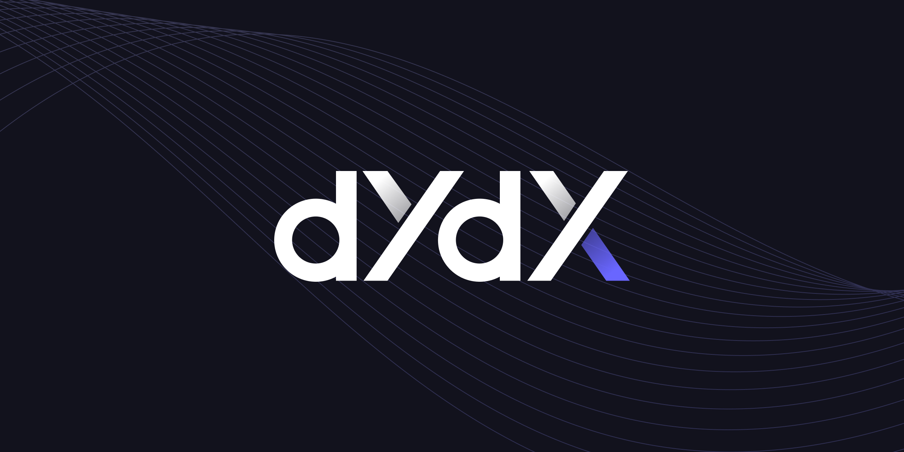
Decentralized Cryptocurrency Exchanges (“DEX”)
A decentralized exchange is another type of exchange that allows peer-to-peer transactions directly from your digital wallet without going through an intermediary. Examples of DEXs include Uniswap
Advantages
Preventing market manipulation
Less censorship

Slide 11
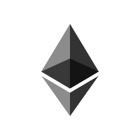
Some technical terms:
Smart Contracts
Wallet
Hash
Token
Faucet
Test net
Liquidity pooling
Etherscan

Slide 12
PROBLEM STATEMENT
To develop a web application that performs exchange of crypto tokens in a decentralized manner with out involvement of any other intermediaries by making use of blockchain technology.

Slide 13
PROPOSED SOLUTION
A web app is developed using modern technologies like react and built the smart contracts, deployed them to blockchain which will operate in the backend.
The transactions can be monitored on the ether scan portal to confirm them.

Slide 14
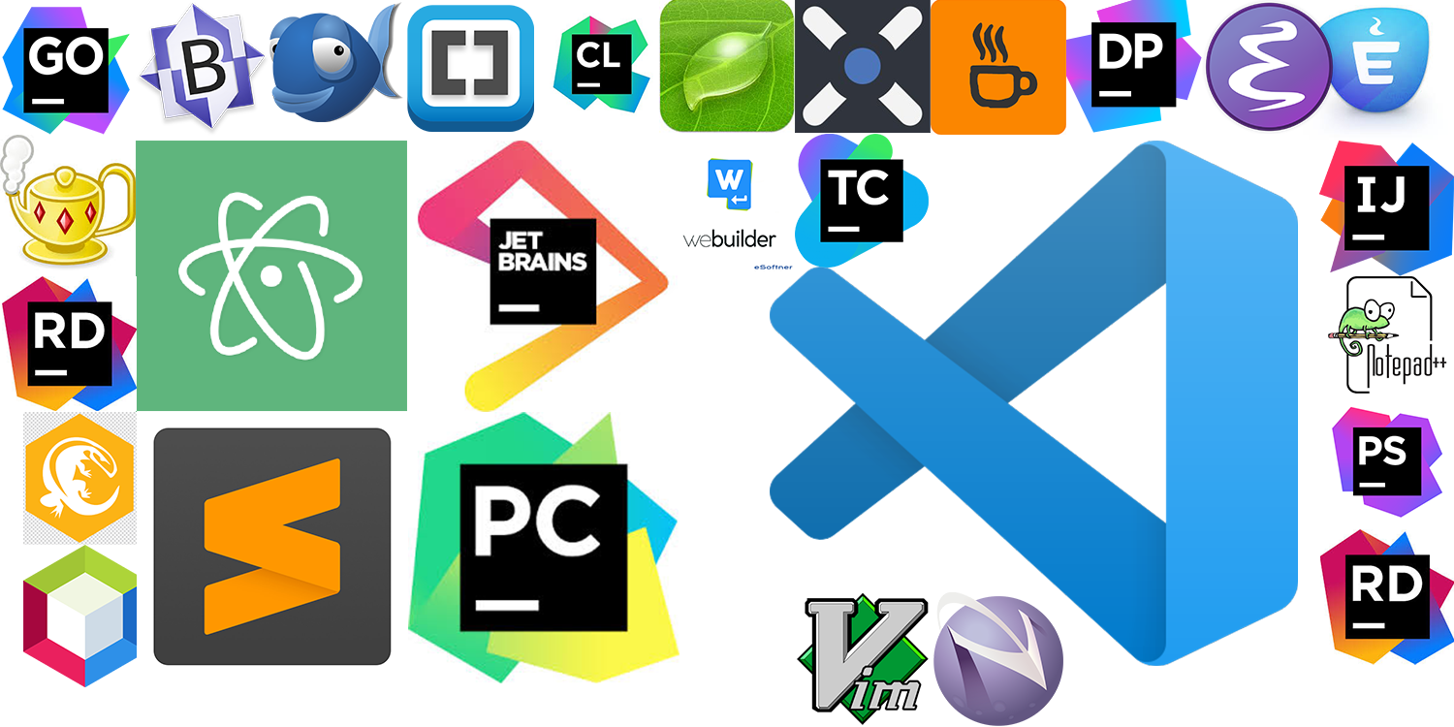
OPERATING ENVIRONMENT
Languages used:
ReactJS, Tailwind CSS
Running Environment:
Any updated browser like Brave/Chrome
Tools used:
VScode, Github, Cranq, Alchemy, useDapp,
Metamask, Goerli Faucet, Goerli Scan
System Requirements:
RAM : 4GB or above
Disk space : 32GB or above
Processor : any updated 64 bit processor
Operating System: Windows/ Mac/ Linux

Slide 15
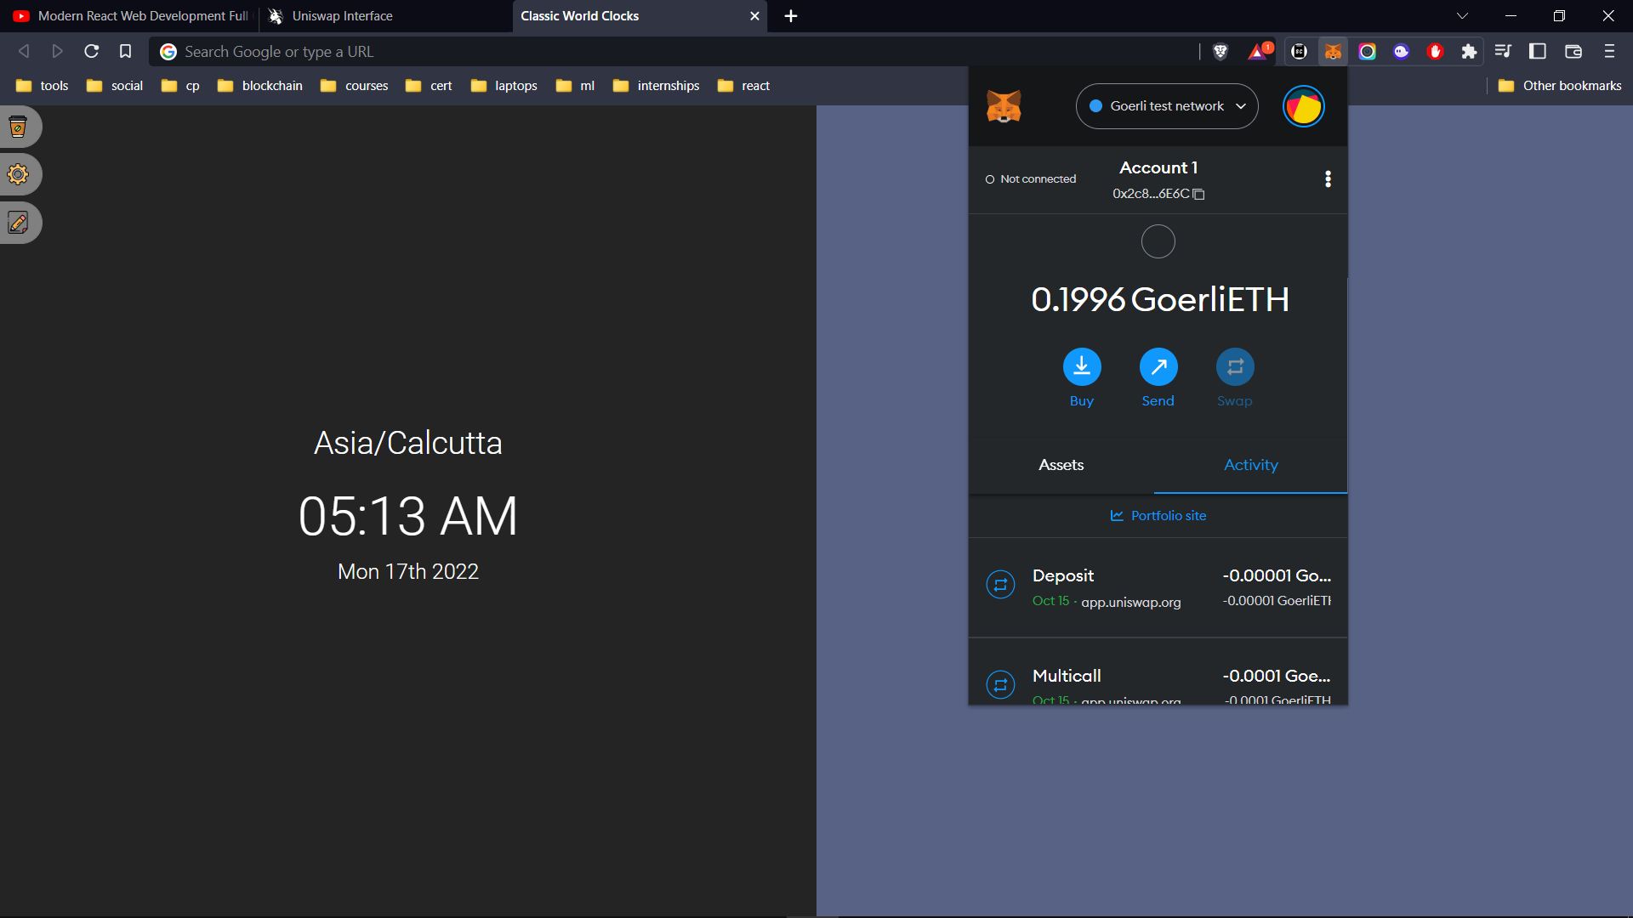
SCREENSHOTS

Slide 16
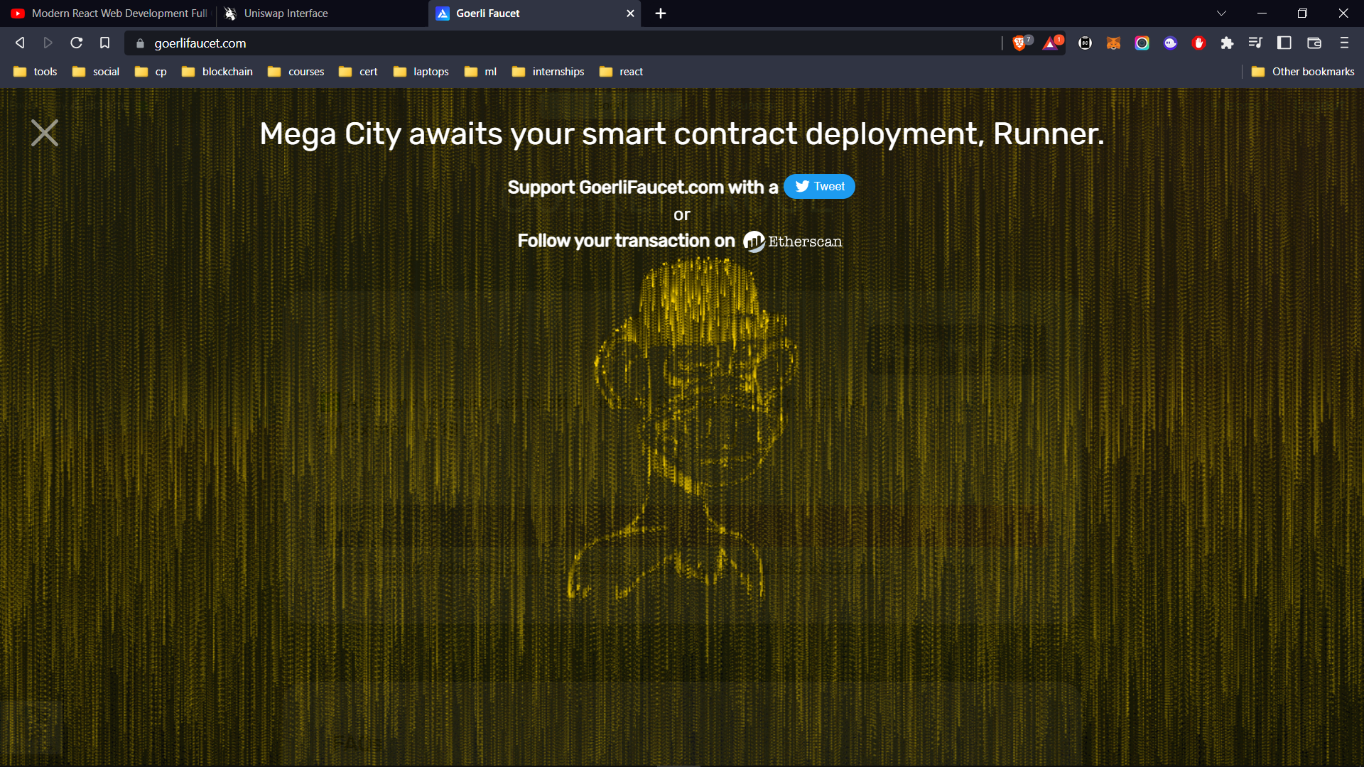

Slide 17
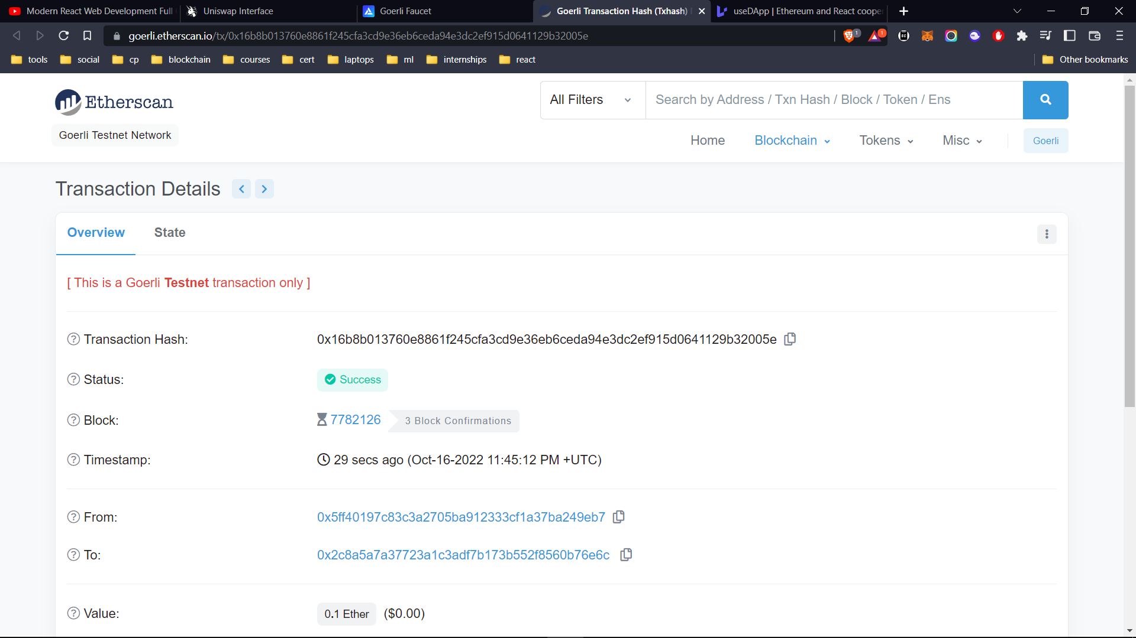

Slide 18
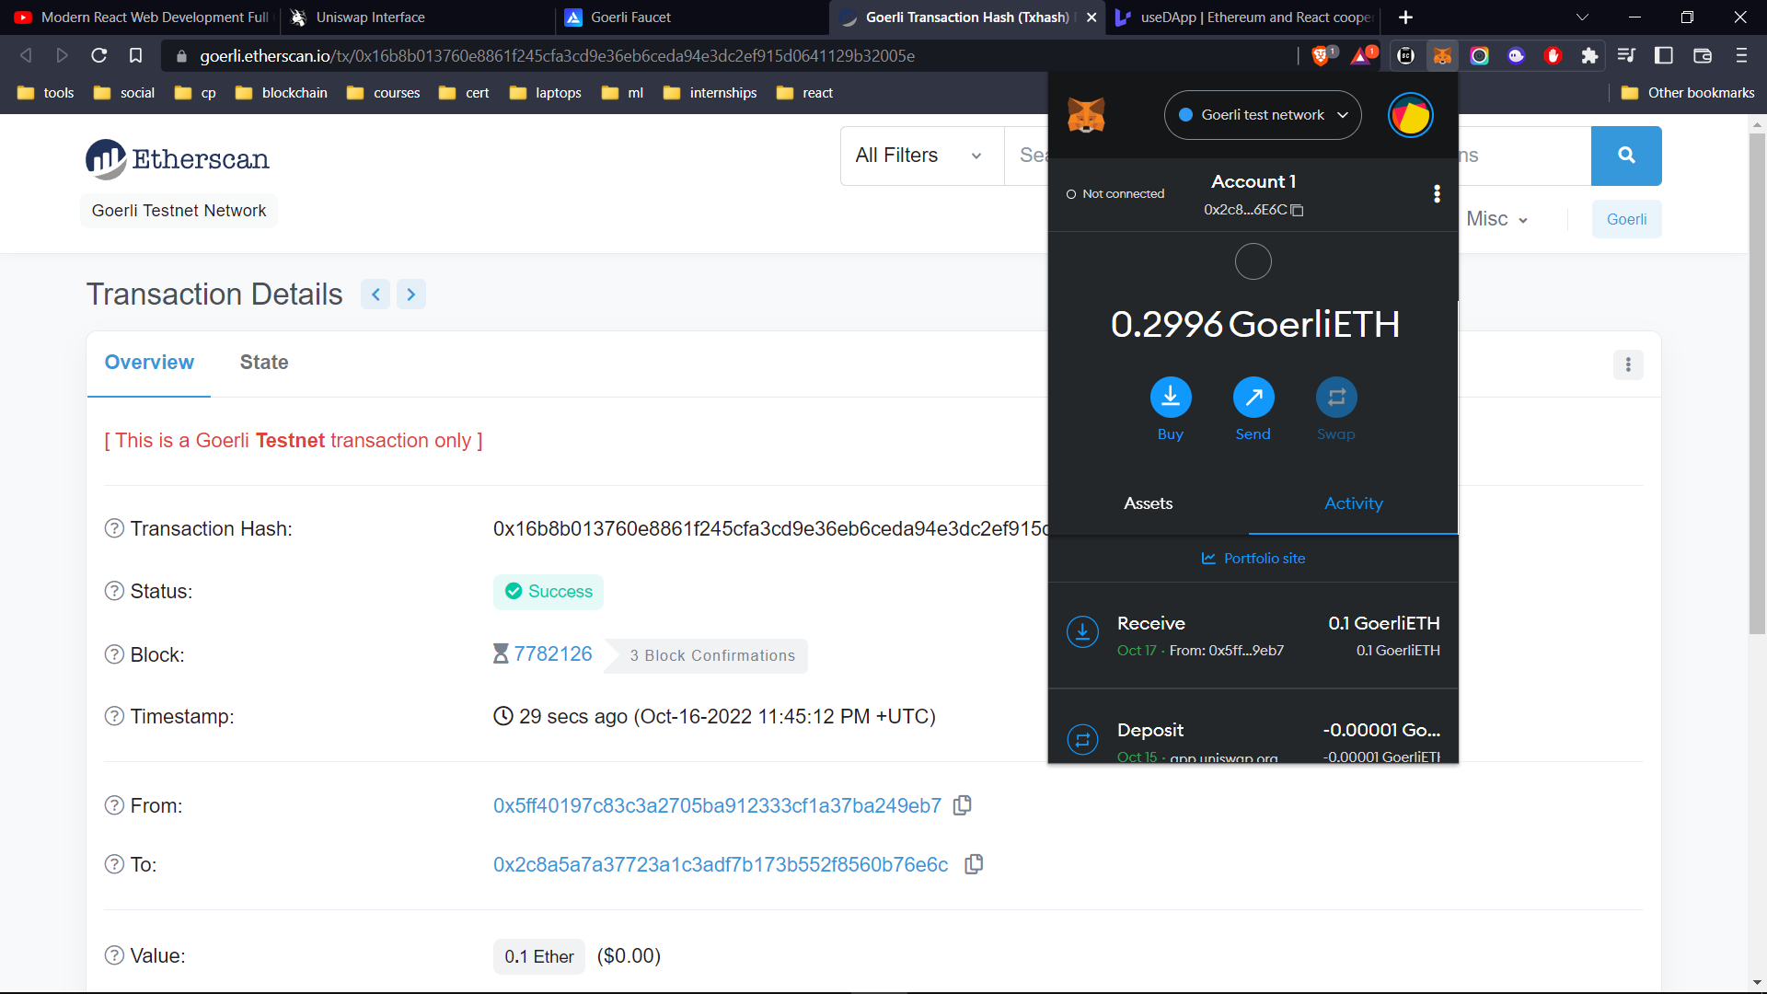

Slide 19
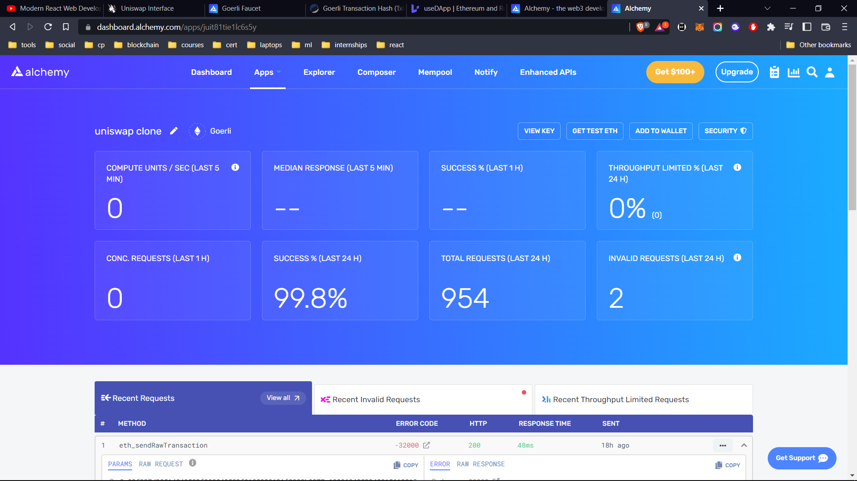

Slide 20
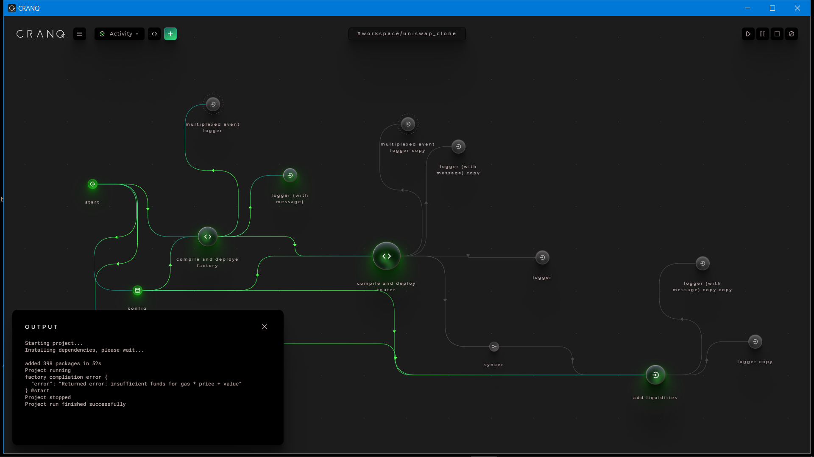

Slide 21
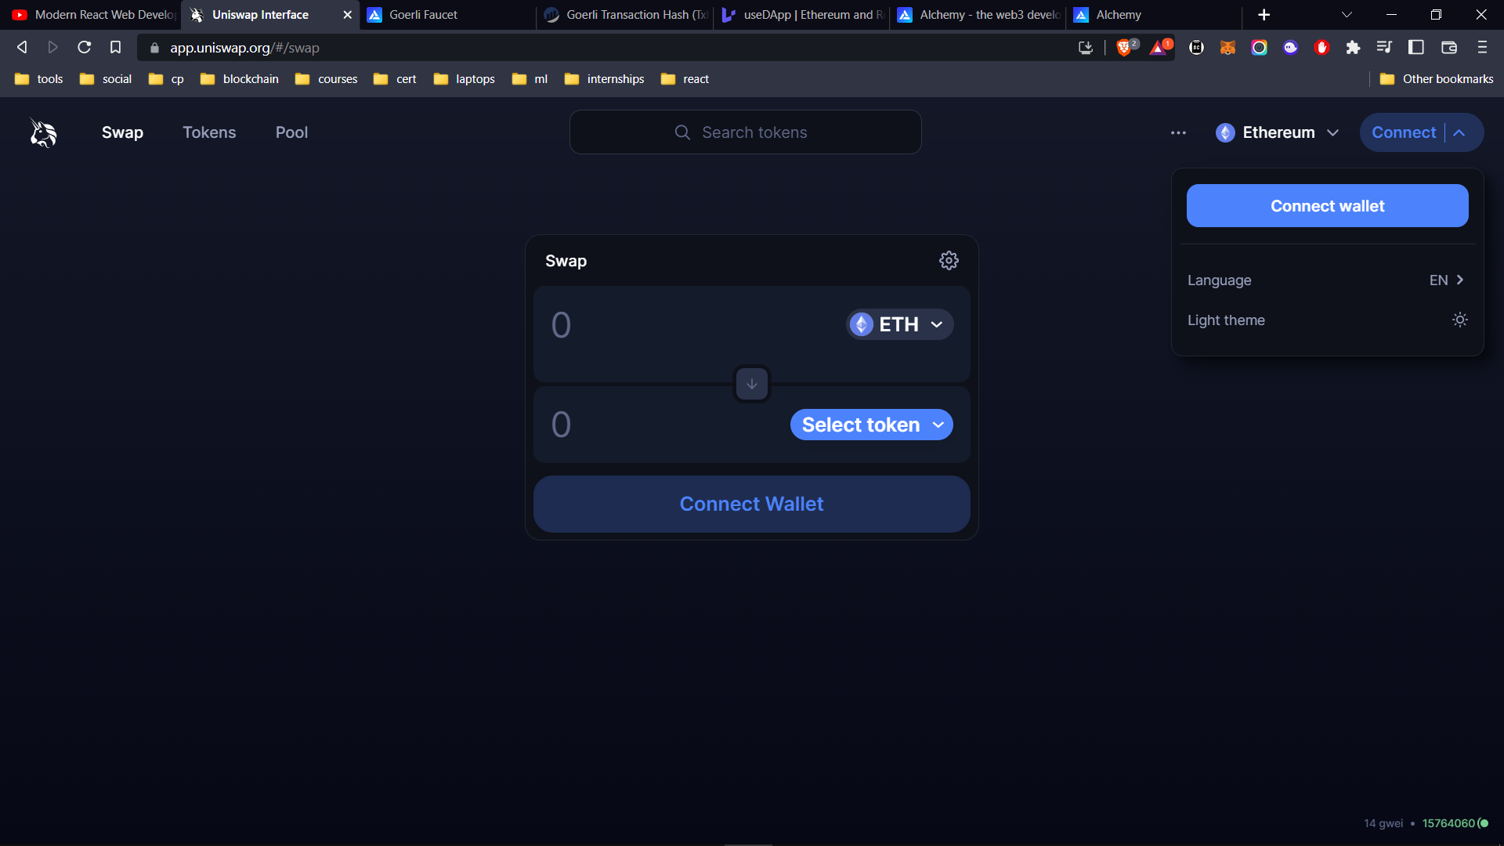

Slide 22
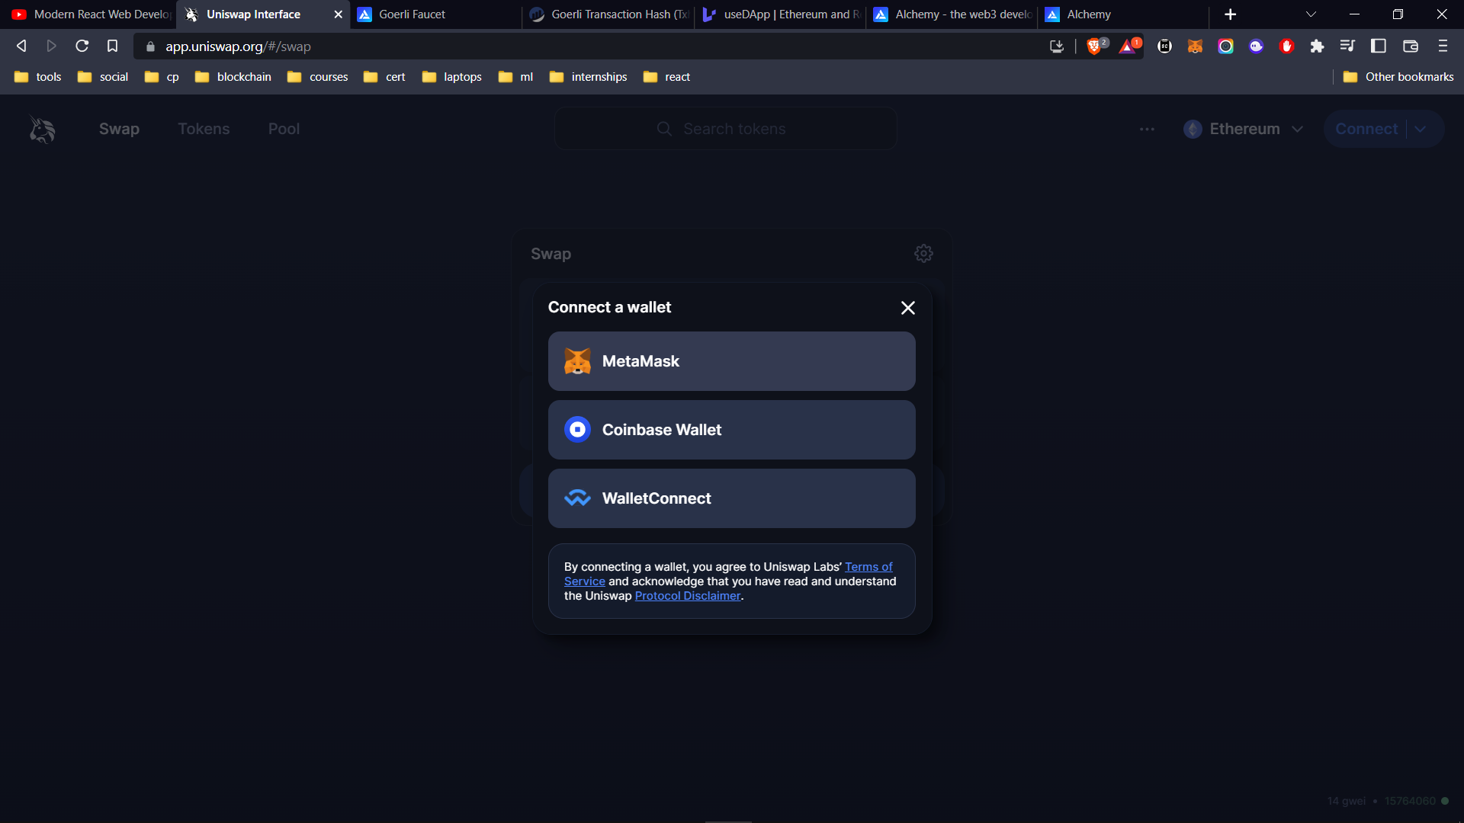

Slide 23
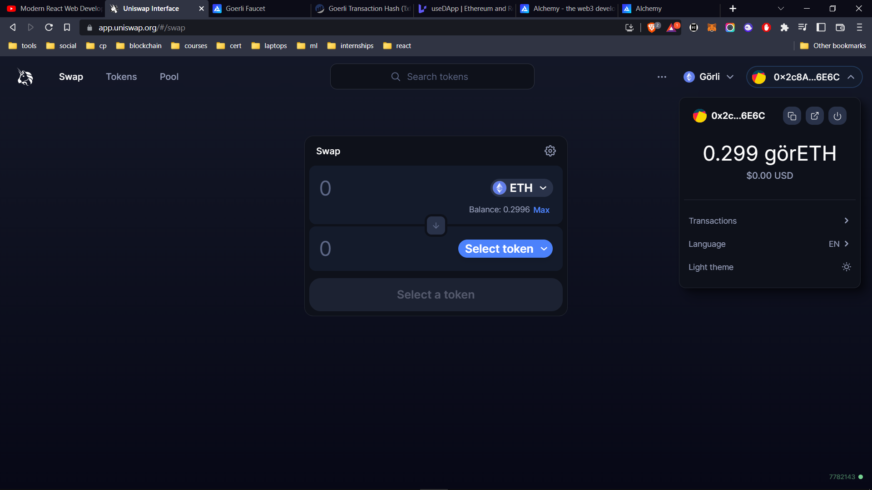

Slide 24
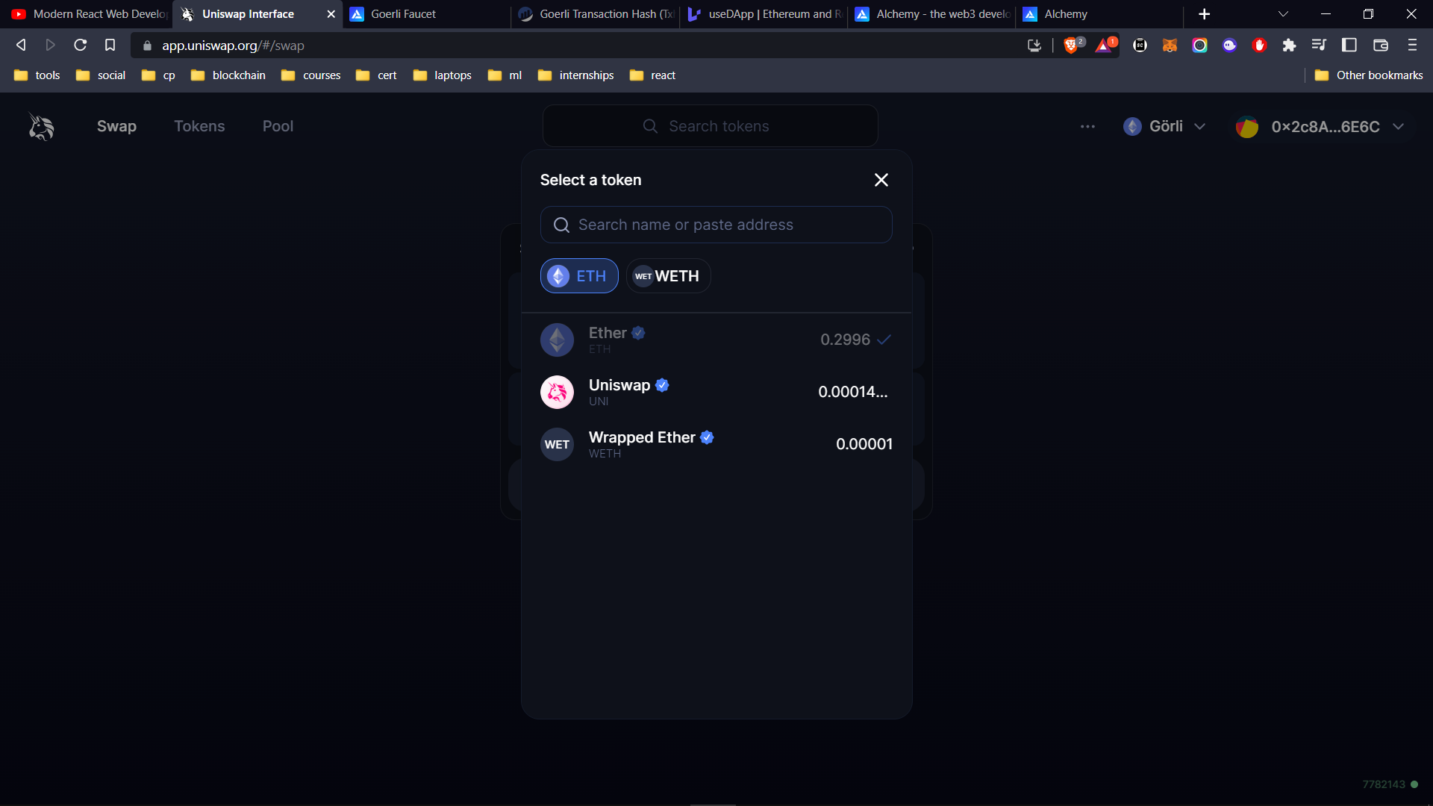

Slide 25
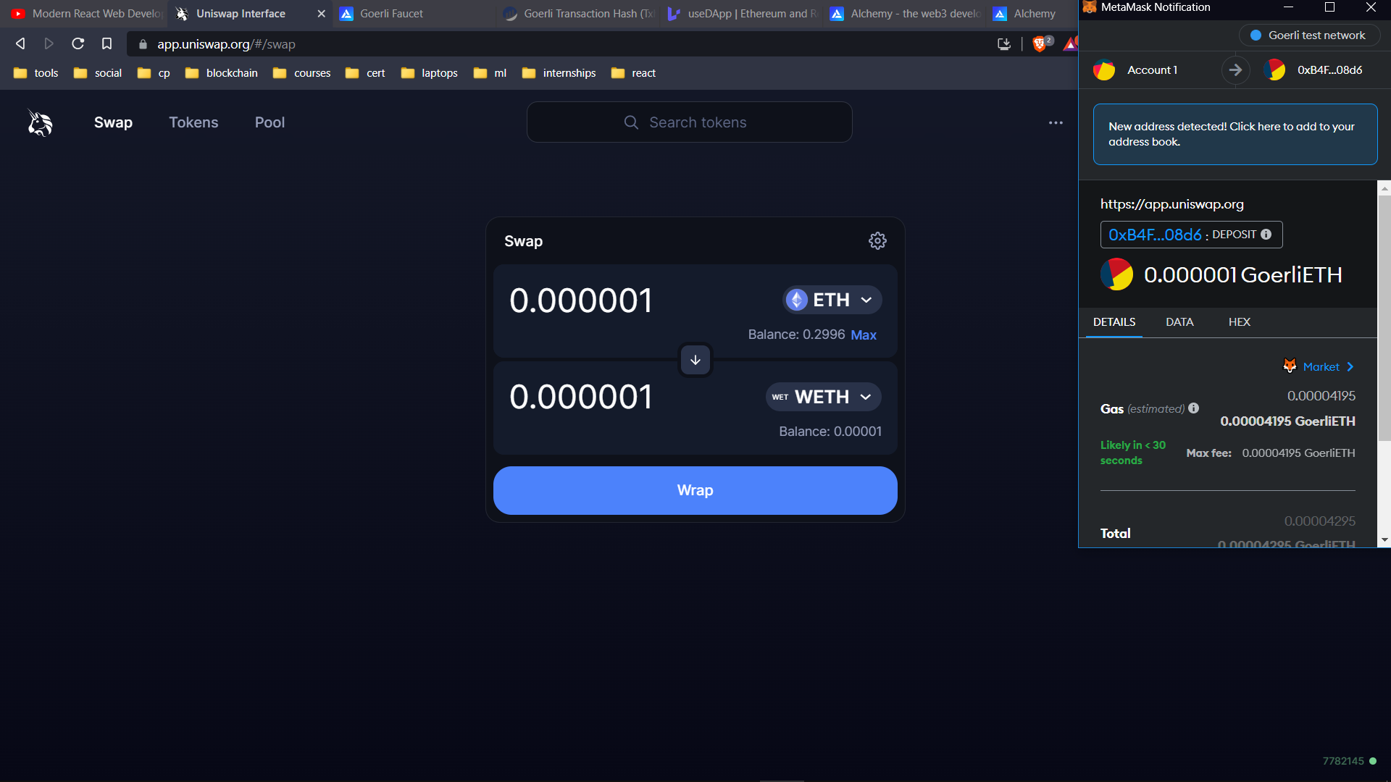

Slide 26
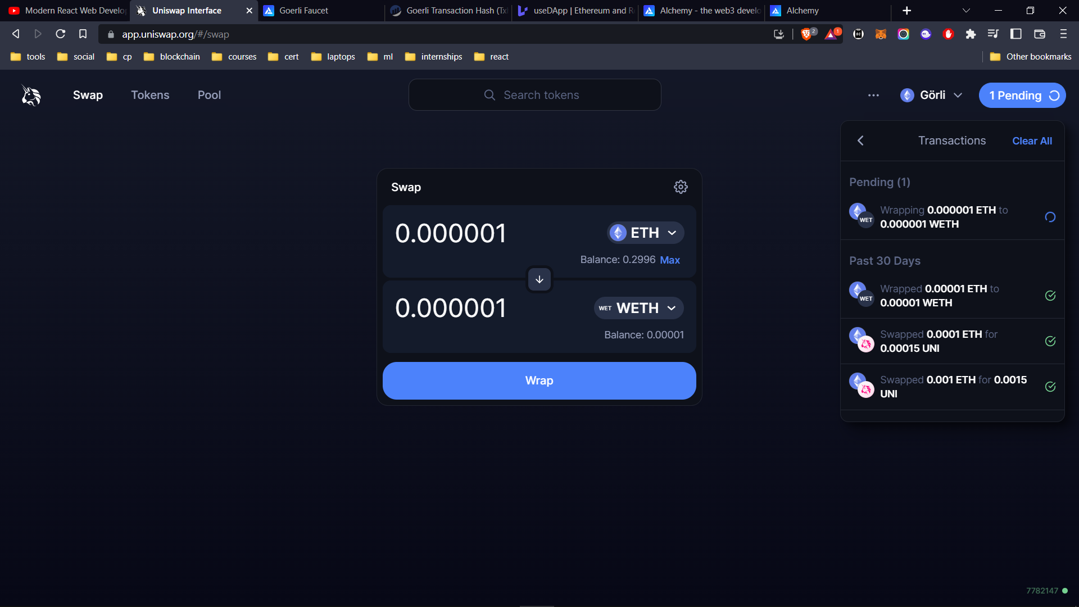

Slide 27
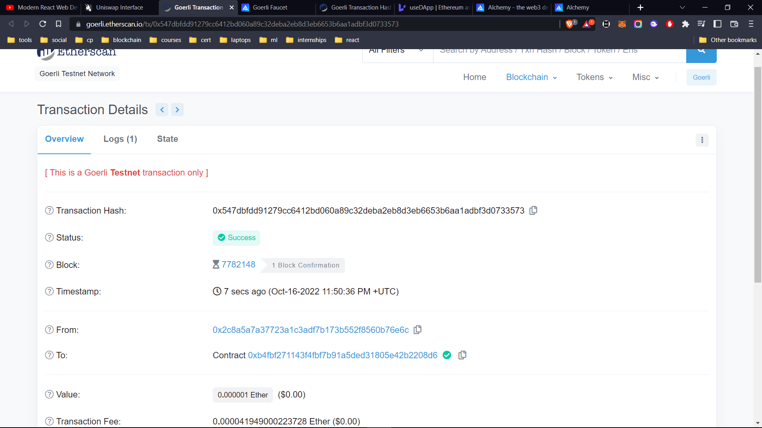

Slide 28
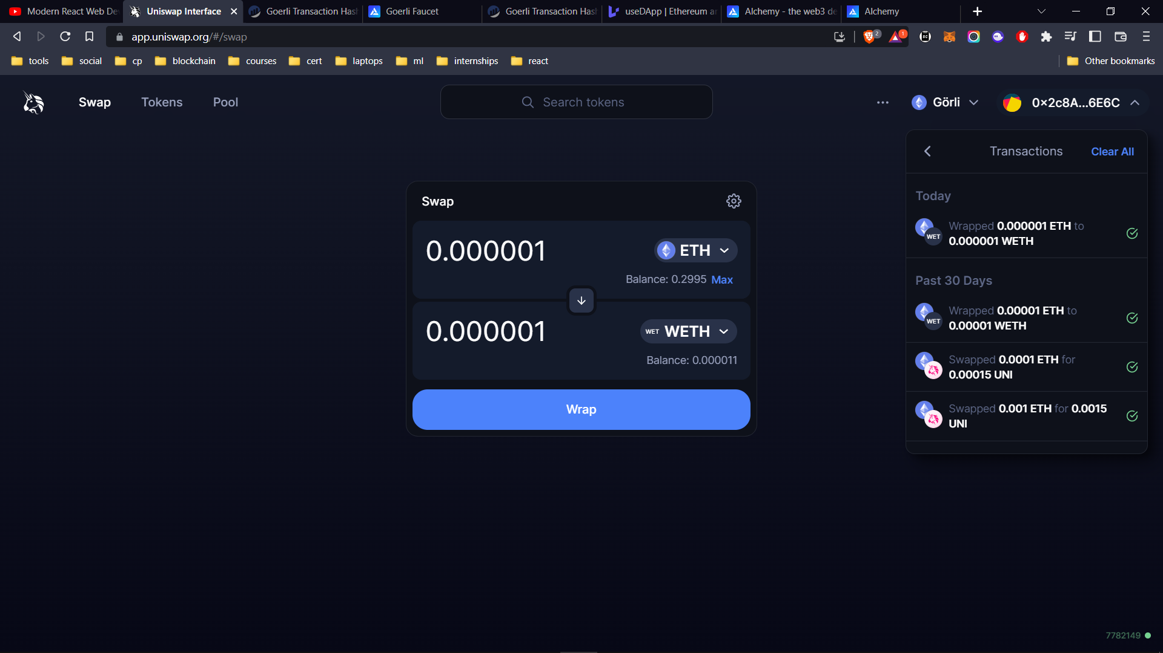

Slide 29
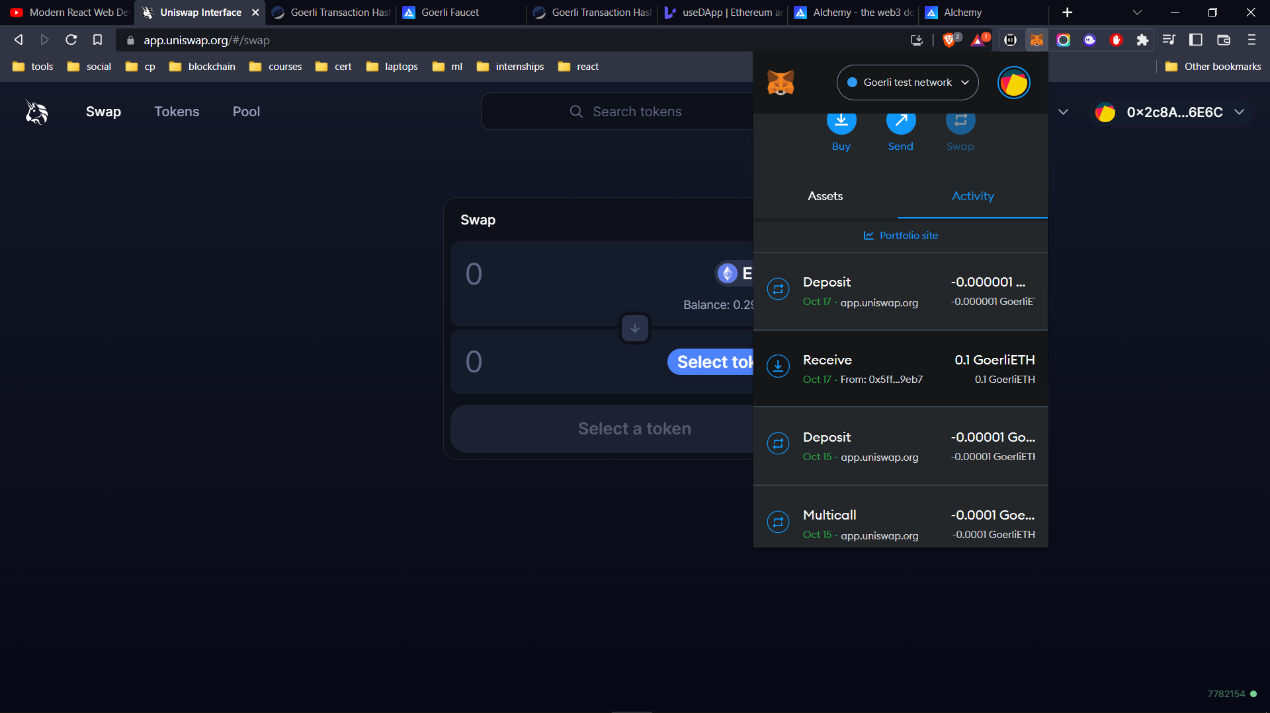

Slide 30


